Slide 1
Gene Expression Analysis of Alzheimer’s-Related Genes Across Disease Stages Using Python-Based Visualization
Nada Khalifi, Kashfia Raisa

Slide 2
Introduction
Alzheimer’s disease (AD): progressive neurodegenerative disorder
Focused on gene expression changes across stages
Goal: Examine stage-specific expression of six AD-related genes (APP,BACE1, CLU,MAPT,PSEN1,TREM2)
Compare Incipient vs Severe stages using Python visualizations

Slide 3
Methods
Data: Public Alzheimer’s gene expression dataset
Preprocessing:
  Column renamed to Stage, ID_REF set as index
  Selected six genes, converted values to numeric
Analysis Tools: pandas, matplotlib, seaborn
Visualizations: Boxplots, heatmap, histogram, summary table

Slide 4
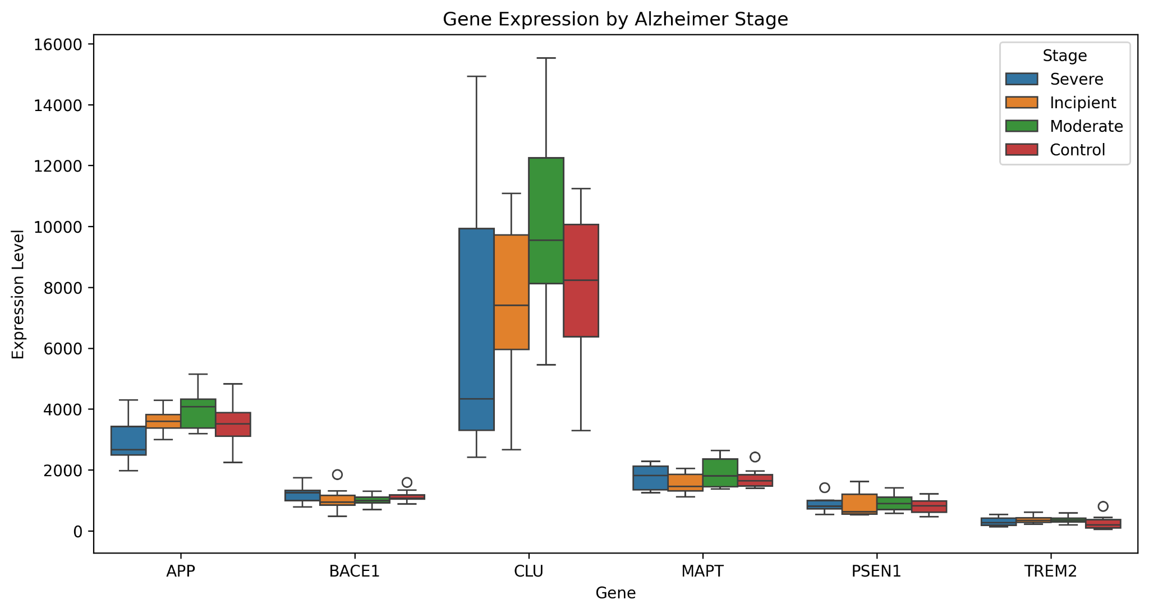
Boxplot of Gene Expression
Explanation :
Compares expression between Severe vs Incipient samples
Median, variability, and outliers shown
MAPT and PSEN1 show largest stage-specific differences
Figure 1: Boxplot (APP, BACE1, CLU, MAPT, PSEN1, TREM2)

Slide 5
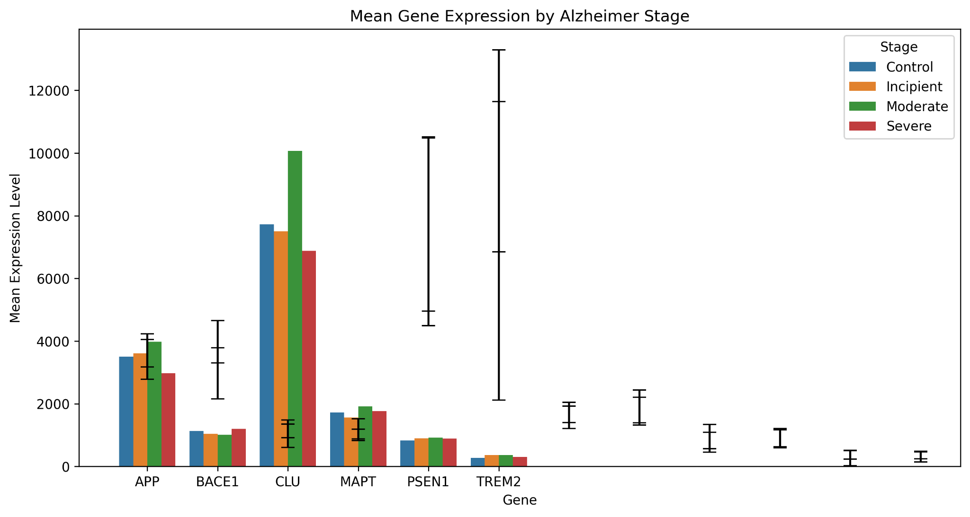
Mean Gene Expression by Stage (Bar Plot)
Explanation:
Summarizes trends seen in box plots (Figure 1).
Positive bars indicate higher mean expression in Severe stage.
Variability shown with error bars highlights consistency across samples.
MAPT and PSEN1 show the largest differences between stages.
Figure 2: Mean Gene Expression by Alzheimer Stage

Slide 6
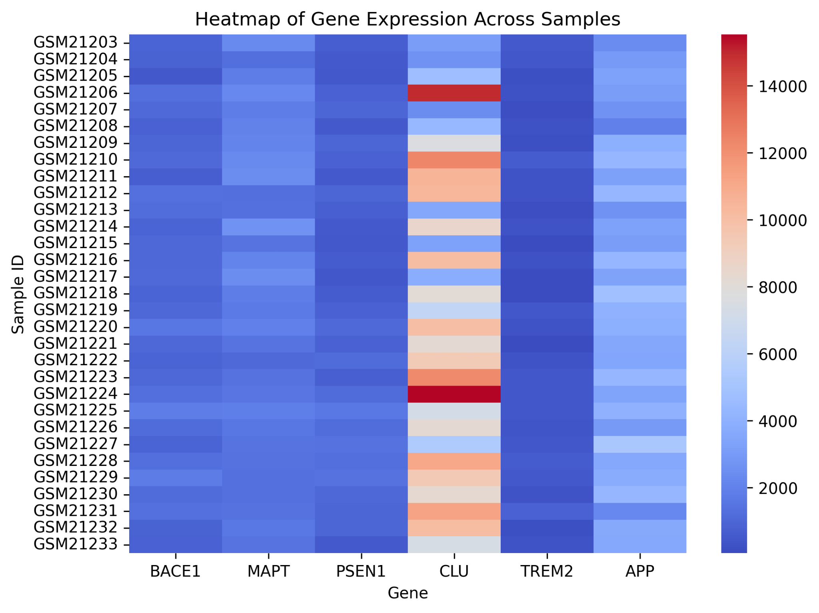
Heatmap Across Samples
Explanation:
Rows: patients, Columns: genes
Genes ordered by fold-change between stages
Color gradient: low → high expression
Highlights consistent upregulation of MAPT and PSEN1 in Severe cases
Figure 3: Heatmap of gene expression across all patients

Slide 7
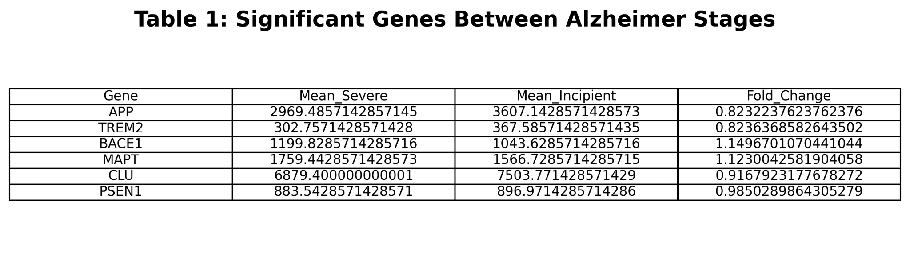
Table of Significant Genes
Explanation:
Shows mean expression per stage + fold-change
Fold-change >1 → higher in Severe, <1 → higher in Incipient
Prioritizes genes with largest differences: MAPT, PSEN1
Table 1: Mean expression & fold-change

Slide 8
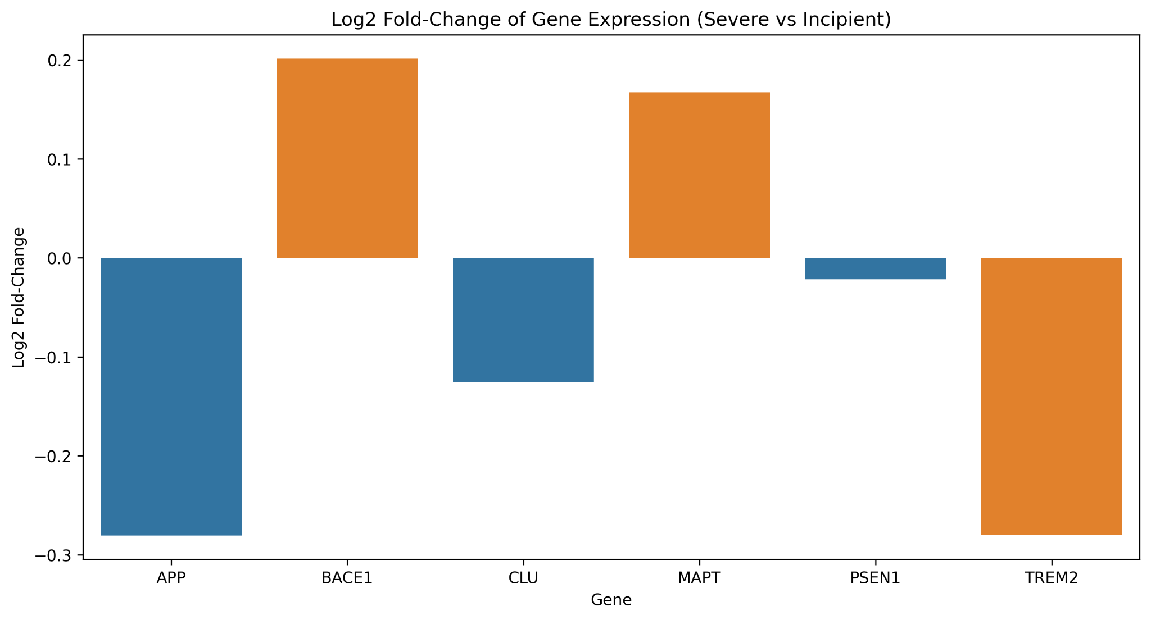
Fold-Change Bar Plot (Severe vs Incipient)
Explanation:
Positive log2 fold-change → gene upregulated in Severe cases.
Negative log2 fold-change → gene downregulated in Severe cases.
Highlights MAPT and PSEN1 as the genes with the strongest changes.
Complements numeric data in Table 1 and visual patterns in Figures 1–3.
Figure 4: Log2 Fold-Change of Gene Expression

Slide 9
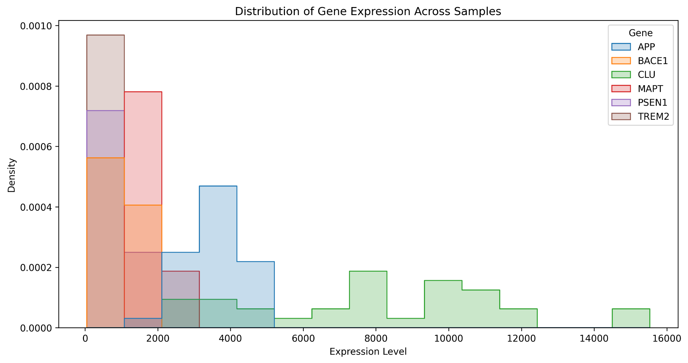
Distribution of Gene Expression
Explanation:
Shows expression variability for each gene
Peaks indicate common expression levels, tails indicate outliers
Highlights genes with consistent vs highly variable expression
Figure 5: Histogram of gene expression across samples

Slide 10
Discussion & Key Findings
MAPT and PSEN1 consistently higher in Severe stage
Boxplots and heatmap reveal stage-specific patterns
Fold-change table confirms key genes for further investigation
Findings align with prior literature (MAPT → tau pathology, PSEN1 → amyloid processing)

Slide 11
Conclusion
Python-based visualization effectively highlights stage-specific transcriptional differences
MAPT and PSEN1 are potential biomarkers of AD severity
Provides foundation for deeper transcriptomic studies

Slide 12
References
Eslami, F. (2025). Alzheimer Gene Expression Dataset. Kaggle
Hunter, J. D. (2007). Matplotlib: A 2D graphics environment
McKinney, W. (2010). Data structures for statistical computing in Python
Python Software Foundation. (2023). Python 3.11 Reference
Waskom, M. L. (2021). Seaborn: Statistical data visualization
Harris, C. R., et al. (2020). Array programming with NumPy

